Slide 1



Reinforcement Learning for Mini-Game Environments Using Gymnasium
Students : Albara Almseidin & Ayham Rababaa
Supervisor : Dr. Mohammad Almseidin
University : Tafila Technical University – 2024/2025
01

Slide 2
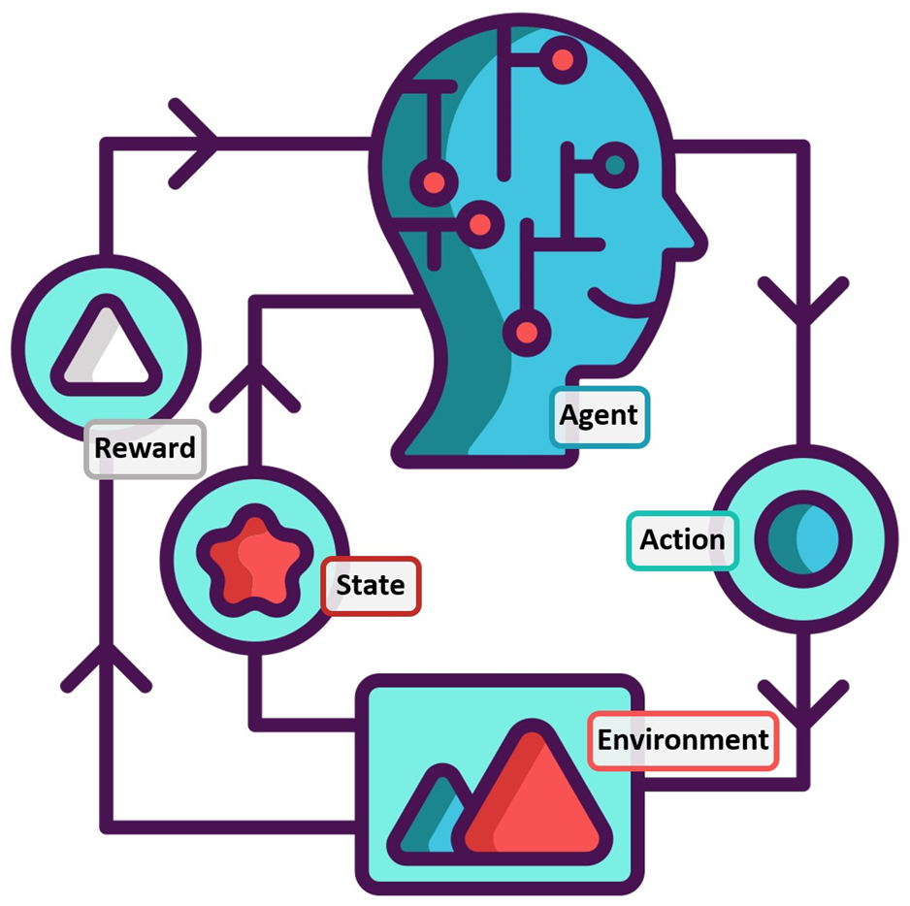
Introduction
Reinforcement Learning (RL) is a machine learning technique where agents learn by interacting with environments.
It doesn’t require labeled data — learning is based on trial, error, and reward.
RL is widely used in robotics, games, self-driving cars, and intelligent systems.
02

Slide 3
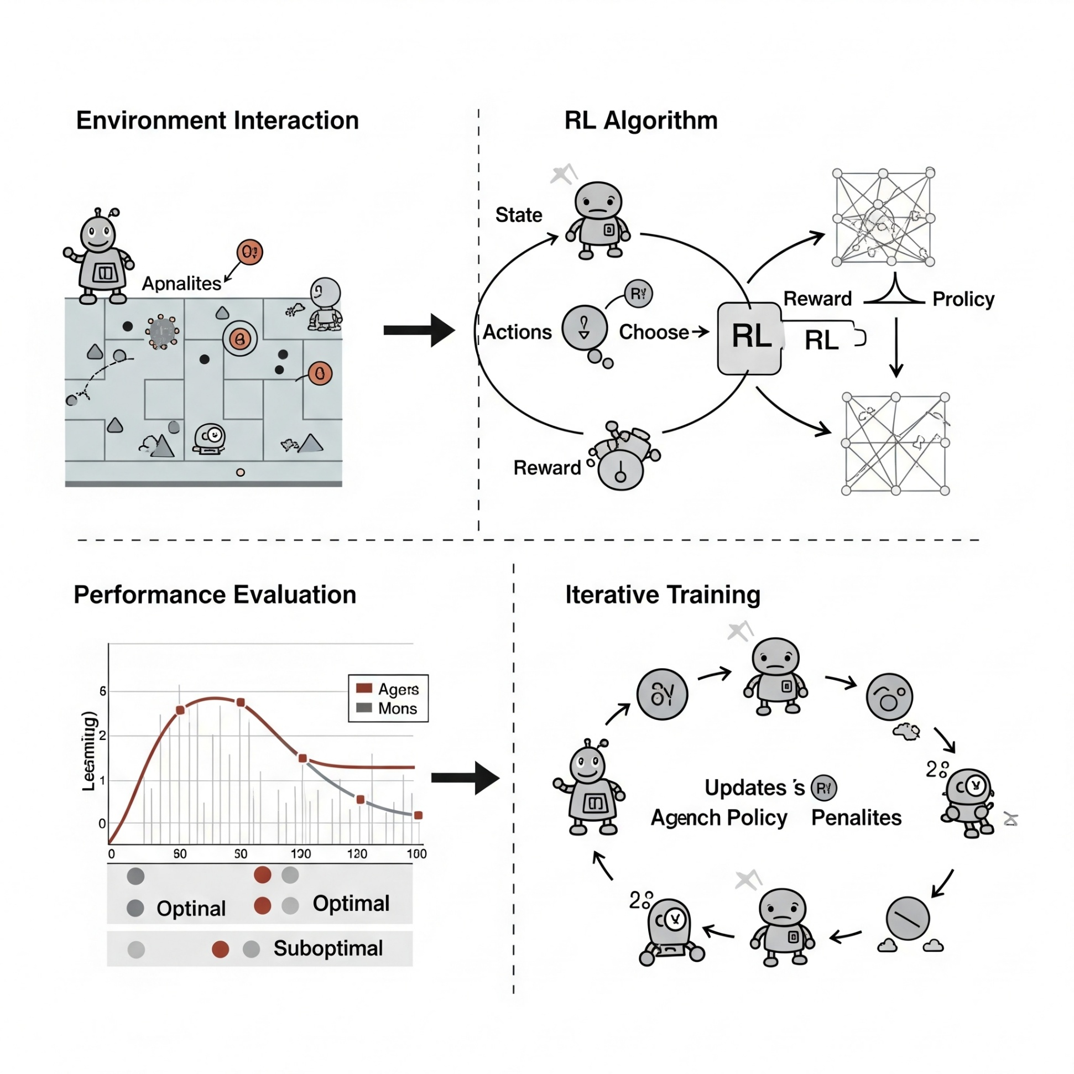
Goals
Train intelligent agents that learn purely through interaction.
Apply and compare 4 RL algorithms across environments of increasing difficulty.
Evaluate each algorithm's learning speed, stability, and final performance.
03

Slide 4
Tools, Algorithms & Environments
Tools & Libraries Used | Algorithm | Environment
Python, NumPy, Gymnasium | Q-Learning | FrozenLake-v1
Python, NumPy, Gymnasium | Deep Q-Network (DQN) | LunarLander-v2
Python, NumPy, Gymnasium | DDPG | BipedalWalker-v3
Python, Stable-Baselines3, VecEnv, Gymnasium | PPO (Stable-Baselines3) | BipedalWalkerHardcore-v3
04

Slide 5

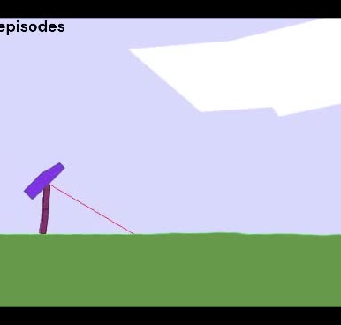
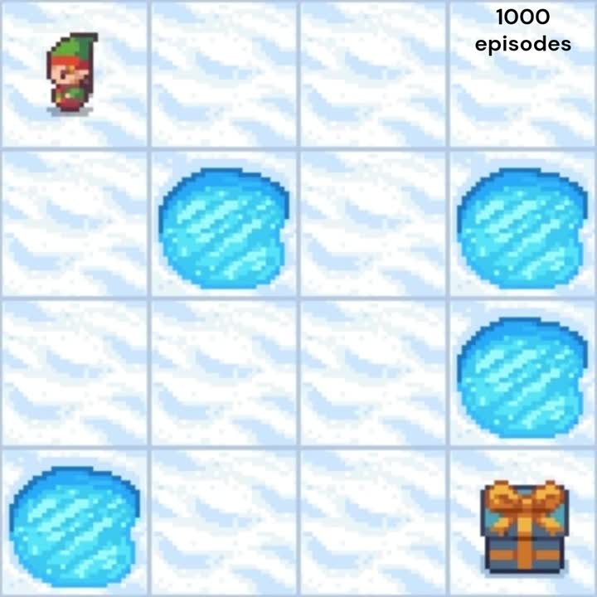
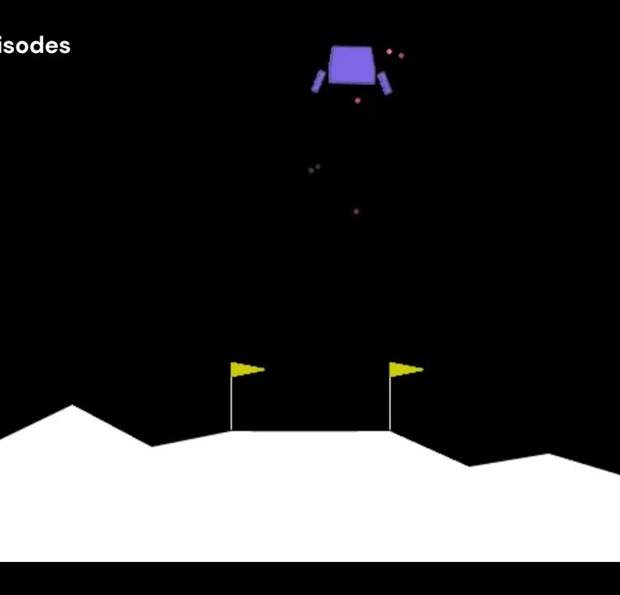
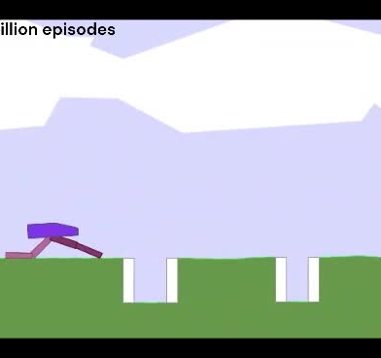
Watch Sample Agent Behaviors
🎬FrozenLake – Q-Learning 🎬
Click to watch
🎬 LunarLander – DQN 🎬
Click to watch
🎬Bipedal Hardcore – PPO🎬
Click to watch
🎬BipedalWalker – DDPG 🎬
Click to watch
05

Slide 6
Summary of Results
Environment | Algorithm | Training Time | Success Rate
FrozenLake-v1 | Q-Learning | Less than 1 minute | 100%
LunarLander-v2 | (DQN) | 20 minute ( GPU ) | 95%
BipedalWalker-v3 | DDPG | 4 hours ( GPU ) | 90%
BipedalWalker Hardcore-v3 | PPO (Stable-Baselines3) | 14 hours ( GPU ) | 77%
06

Slide 7
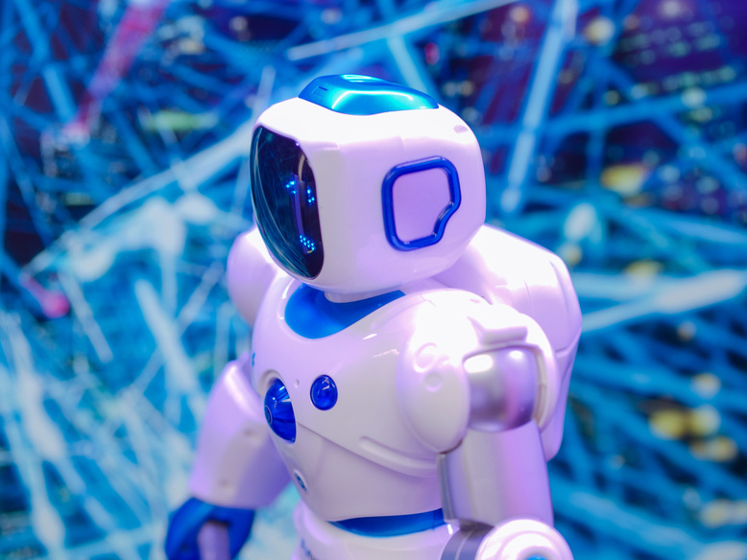
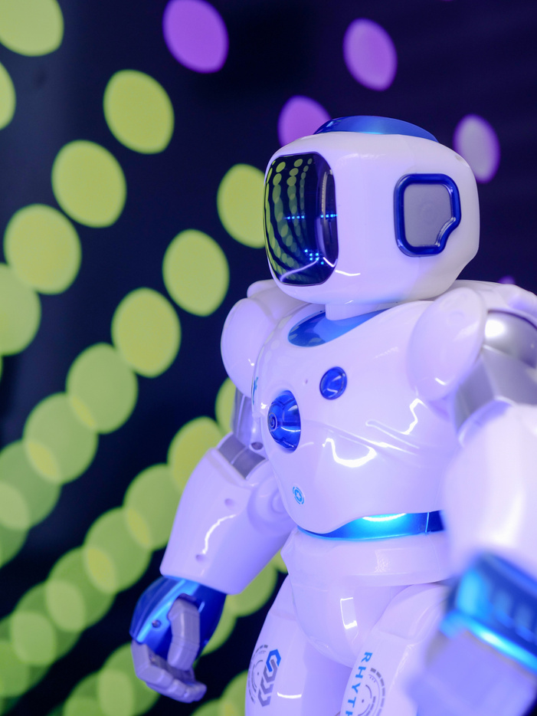
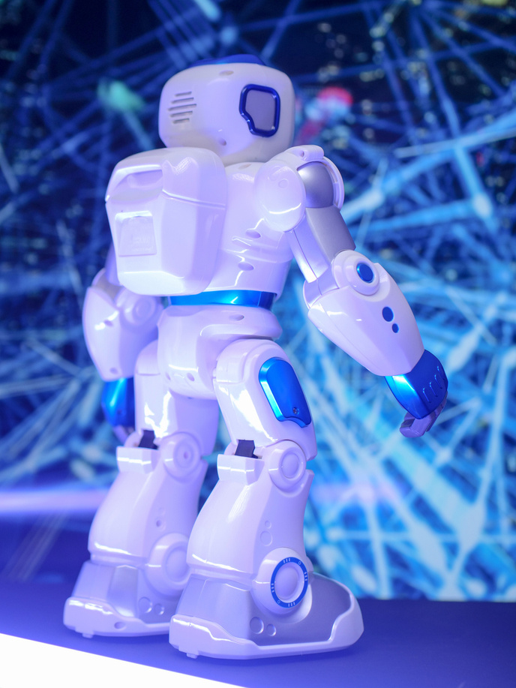
Challenges
Unstable learning in early
training stages
High sensitivity to hyperparameters (especially in DDPG)
Long training times for complex environments
Sparse reward settings made learning harder
07

Slide 8

Recommendations &
Future Work
Use parallel environments (VecEnv)
to speed up training
Save checkpoints and monitor training
performance regularly
Try more advanced algorithms ( A3C , TQC , e.g.)
Explore real-world simulators like MuJoCo or PyBullet
08

Slide 9

Conclusion
RL proved effective in training agents without pre-existing data
Each algorithm has its strengths depending on the task complexity
Thanks to our supervisor, faculty, families, and colleagues
09

Slide 10
That Concludes our Presentation
Thank you for your time and attention
Reinforcement learning is just the beginning the future is full of possibilities.
10

